Slide 1
IoT Unleashed Temperature Monitor
Presenter ::
Sudhanshu Gupta

Slide 2
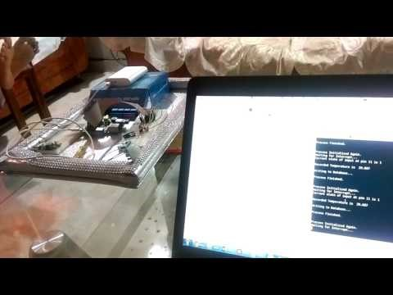
Demo
Video

Slide 3

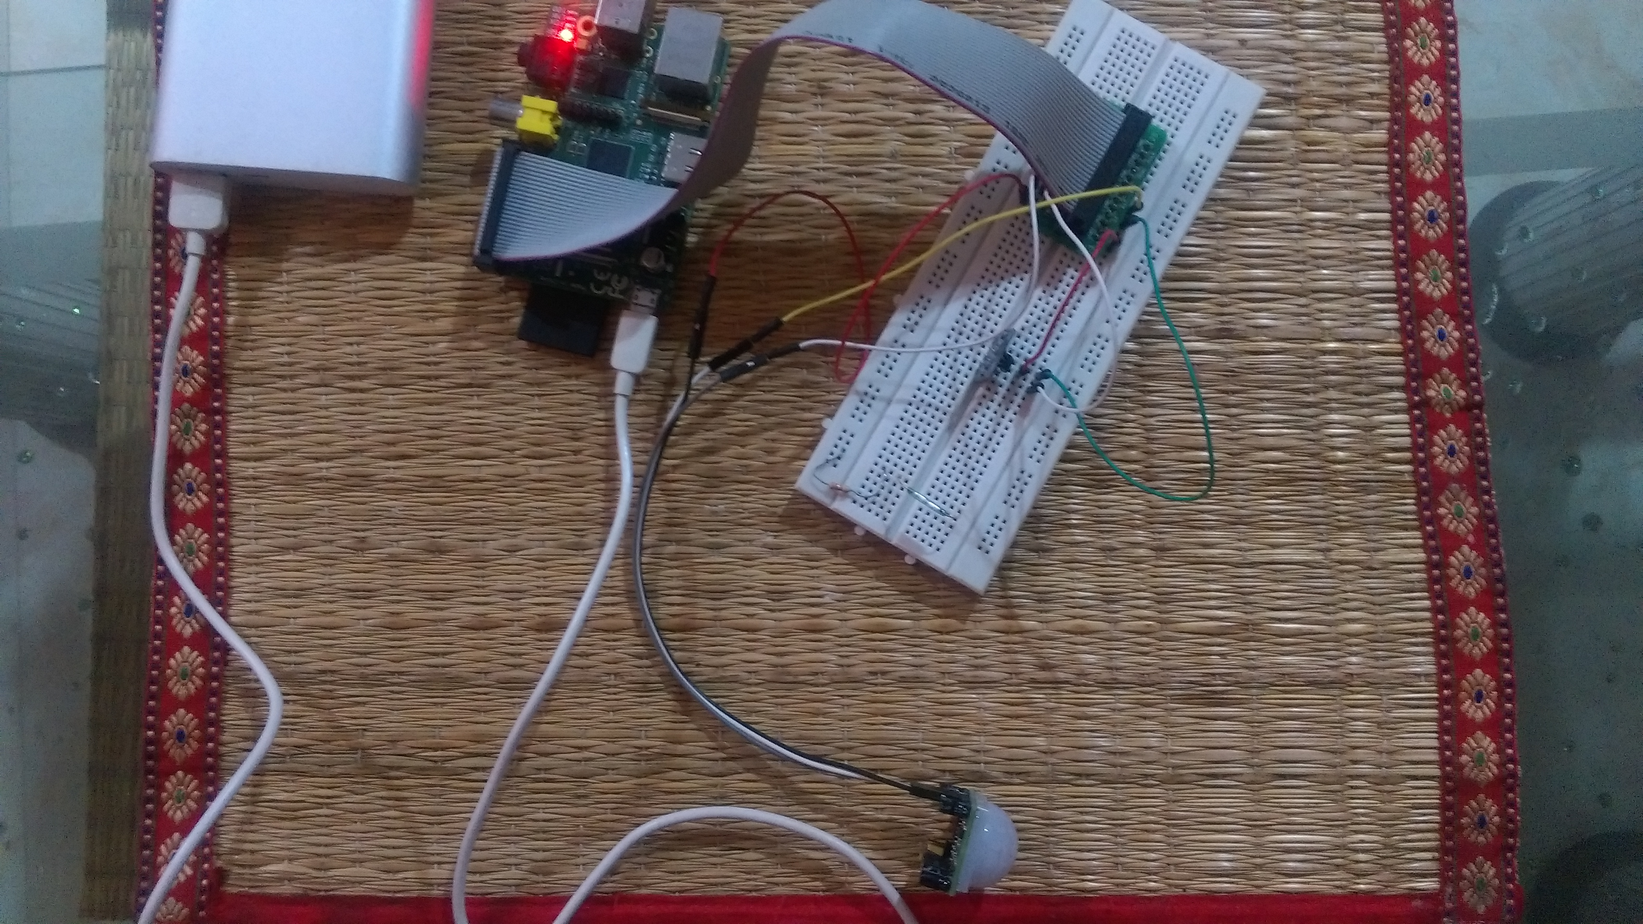
Physical Setup

Slide 4
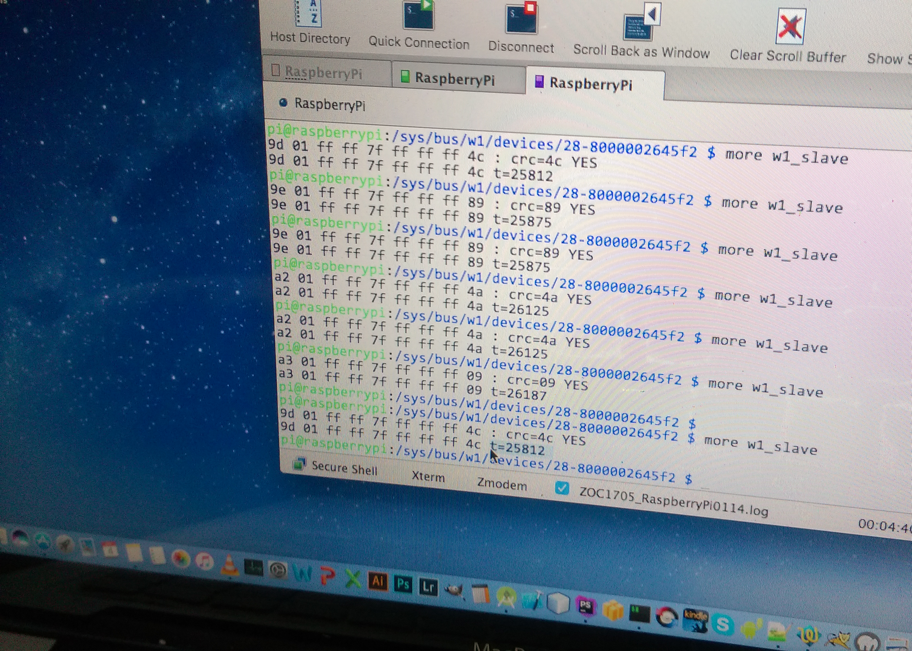

Slide 5


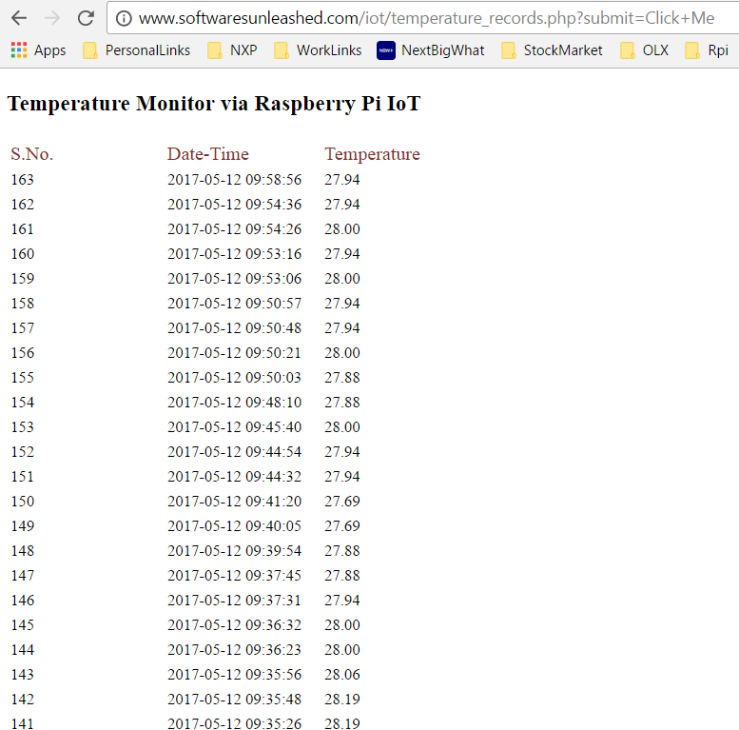
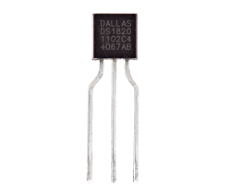
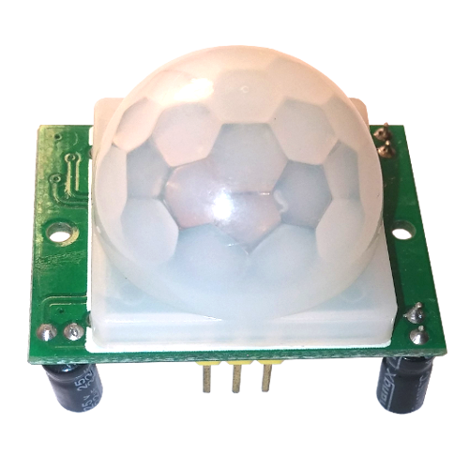
Arch Overview
Cloud Services
(Firebase / PHP)
Air Interface
WiFi
DevBoard
(Raspberry Pi)
DS1820
Temperature Sensor
GPIO
GPIO #4
3.3v
GND
5 v
PIR
Motion Sensor
GPIO #22 (Pin 11)

Slide 6

Work Flow Diagram
(Scenario 1)

Slide 7
Work Flow Diagram
(Scenario 2)

Slide 8
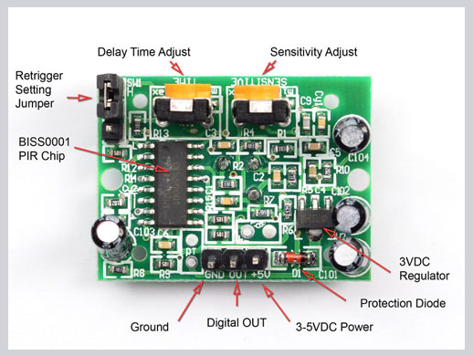

Slide 9
Cloud / Backend

Slide 10
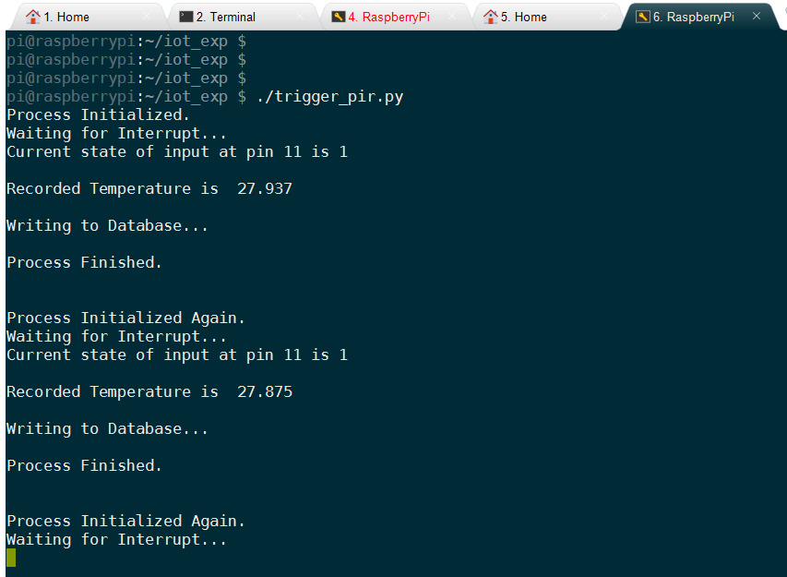
Console Output

Slide 11

Code - Python

Slide 12
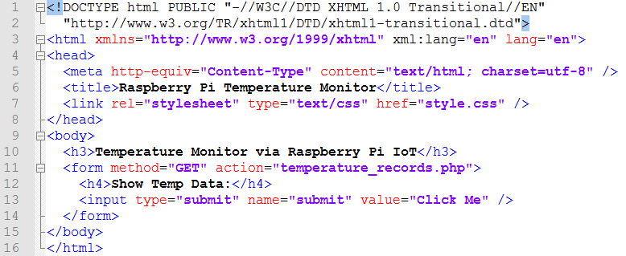
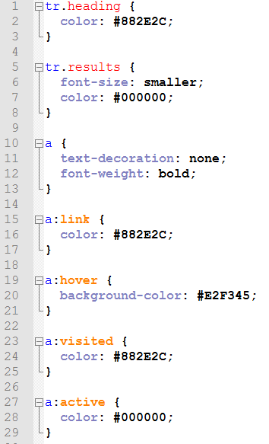
index.html
HTML / CSS
Welcome Page
style.css

Slide 13
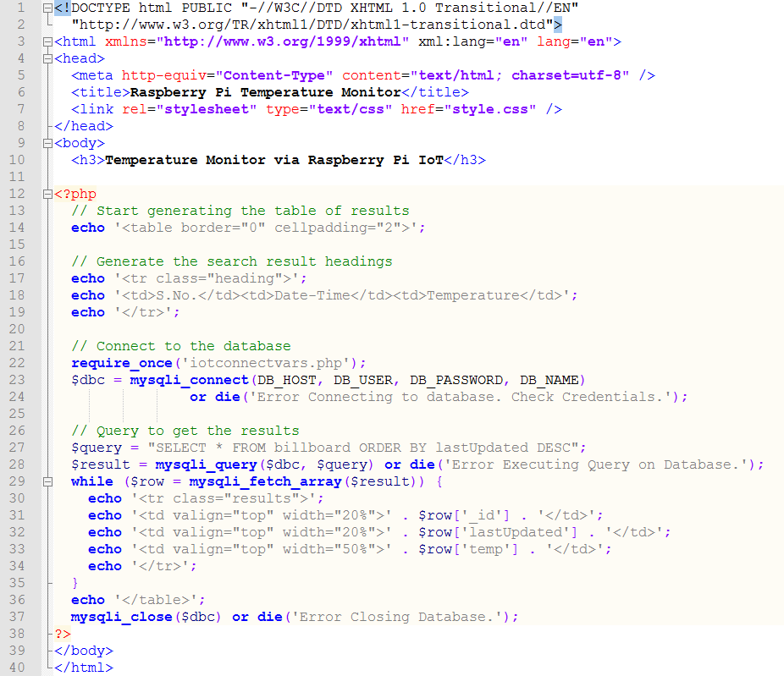
temperature_records.php
Push Temperature Data
To Cloud Server

Slide 14
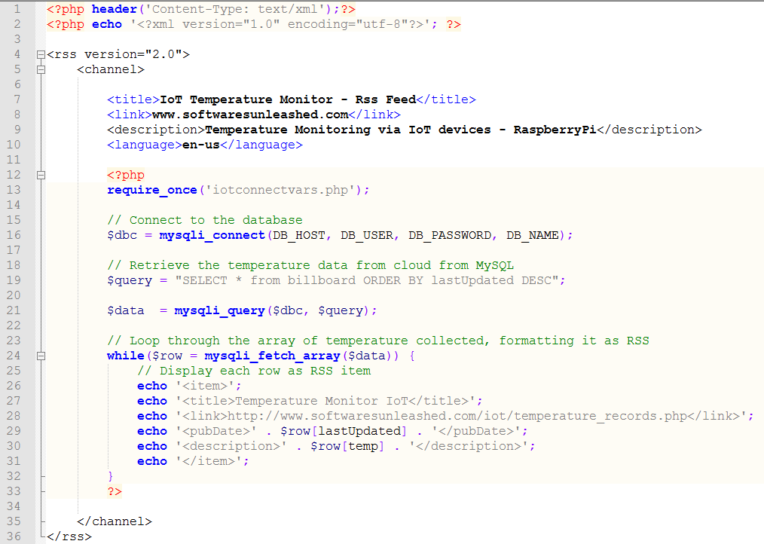
temperature_monitor_rssfeed.php
RSS Feed

Slide 15
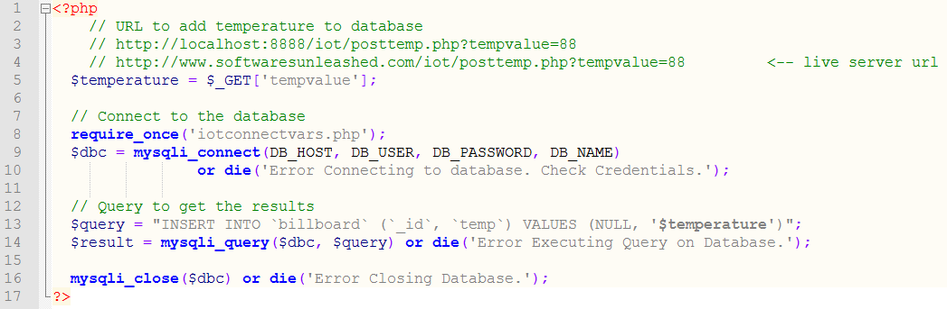
Temperature Posting Script To The Cloud
iotconnectvars.php

Slide 16
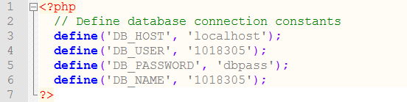
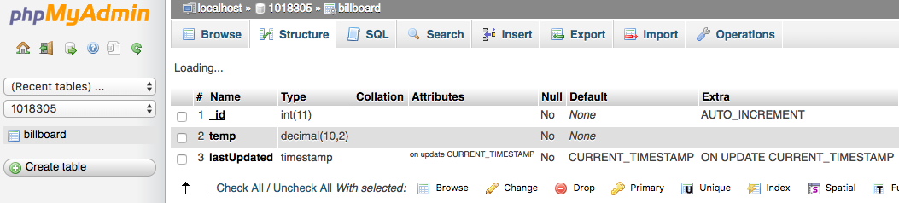
DB Connection Helper
Temp DB Table Structure

Slide 17
Sending Notification to Registered Devices
(Android , iOS, Web Client)

Slide 18
Wrong wiring / connections done between GPIO port & DS1820 temperature sensor
GPIO #4 had to be registered with W1 drivers via /boot/config.txt file.
(Name of the GPIO pin had to be used, and not the physical GPIO pin number.)
The timing / sensitivity rotatory rheostats had to be configured to generate little time duration interrupts.
Major Hurdles Conquered

Slide 19
Python (GPIO Pin Configuration)
PHP / MySQL (Cloud / Backend)
HTML / CSS (Welcome / Temperature Display Page)
Technologies Exploited

Slide 20
PHP Storm (Backend Code)
Android Studio (Android App)
vi / vim (Python Scripts on RaspberryPi)
Softwares

